Slide 1
Unit 202: Principles of electrical science
Electronic systems

Slide 2
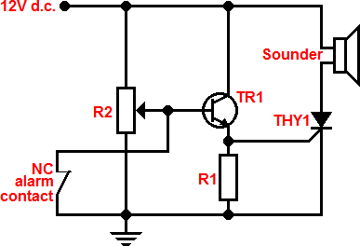
Electronic systems
Security alarm system

Slide 3
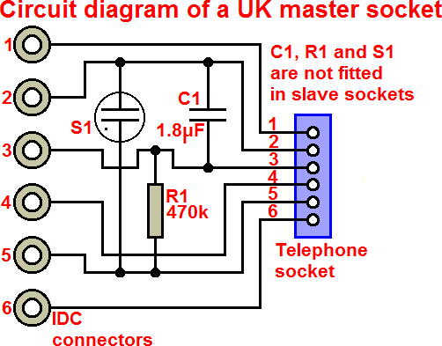
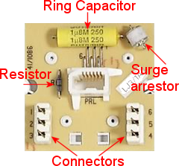
Electronic systems
Telephone systems

Slide 4
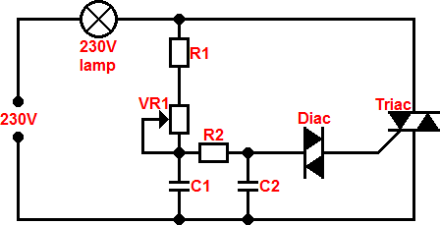
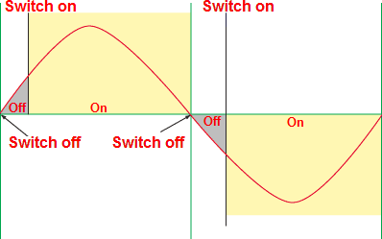
Electronic systems
Light dimming

Slide 5
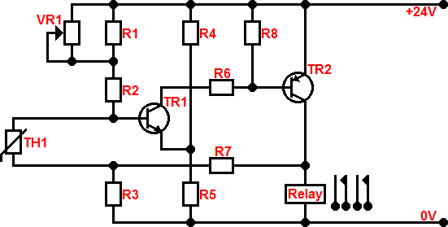
Electronic systems
Heating controls

Slide 6
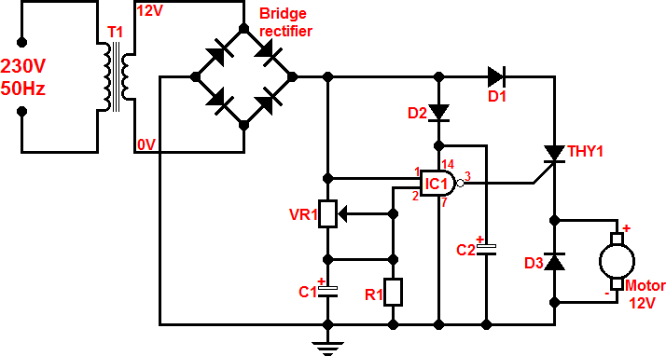
Electronic systems
Motor control

Slide 7
Electronic systems
Wireless control systems
With advances in electronics and particularly with most premises now having Wi-Fi, wireless control of accessories is now within the range of most households. This will have the following benefits:
Allows portable and remote control of accessories.
Control and adjustment of lights, on/off or create lighting scenes.
Control shutters, blinds, gates, latches and garage doors.
Manual or automatic control.
Monitor window or door opening.
Simulate occupancy when you are away from home.

Slide 8
Unit 202: Principles of electrical science
The End

